Slide 1
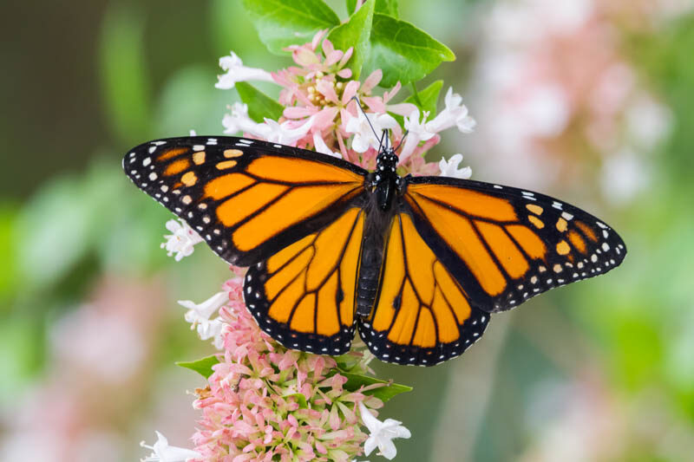
Monarch Butterflies and Microclimate
STAT 414
Kyle Nessen, Justin Mai, Aiden Kelly, Arneh Begi

Slide 2
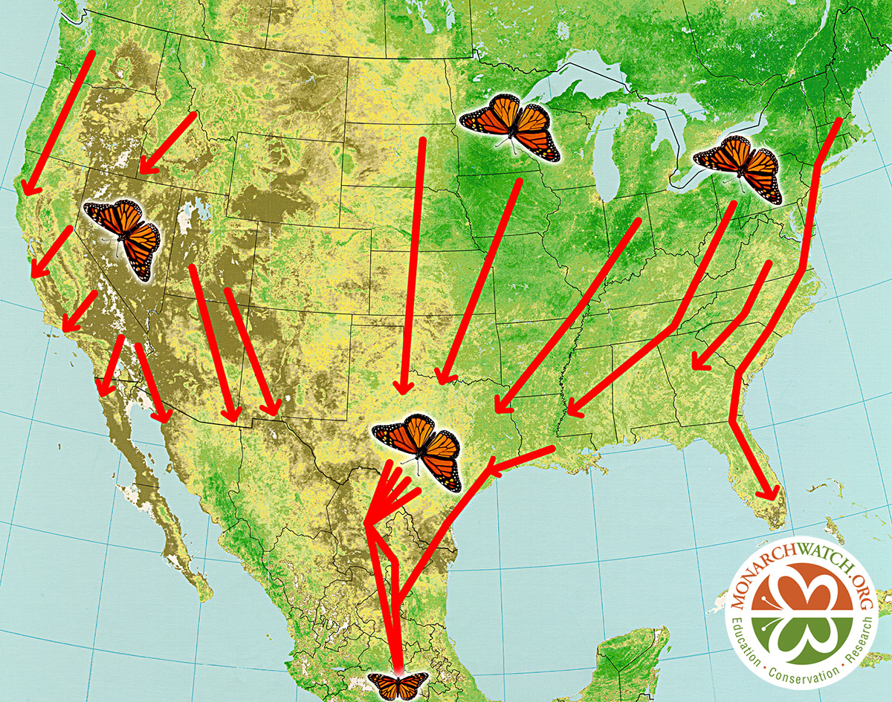
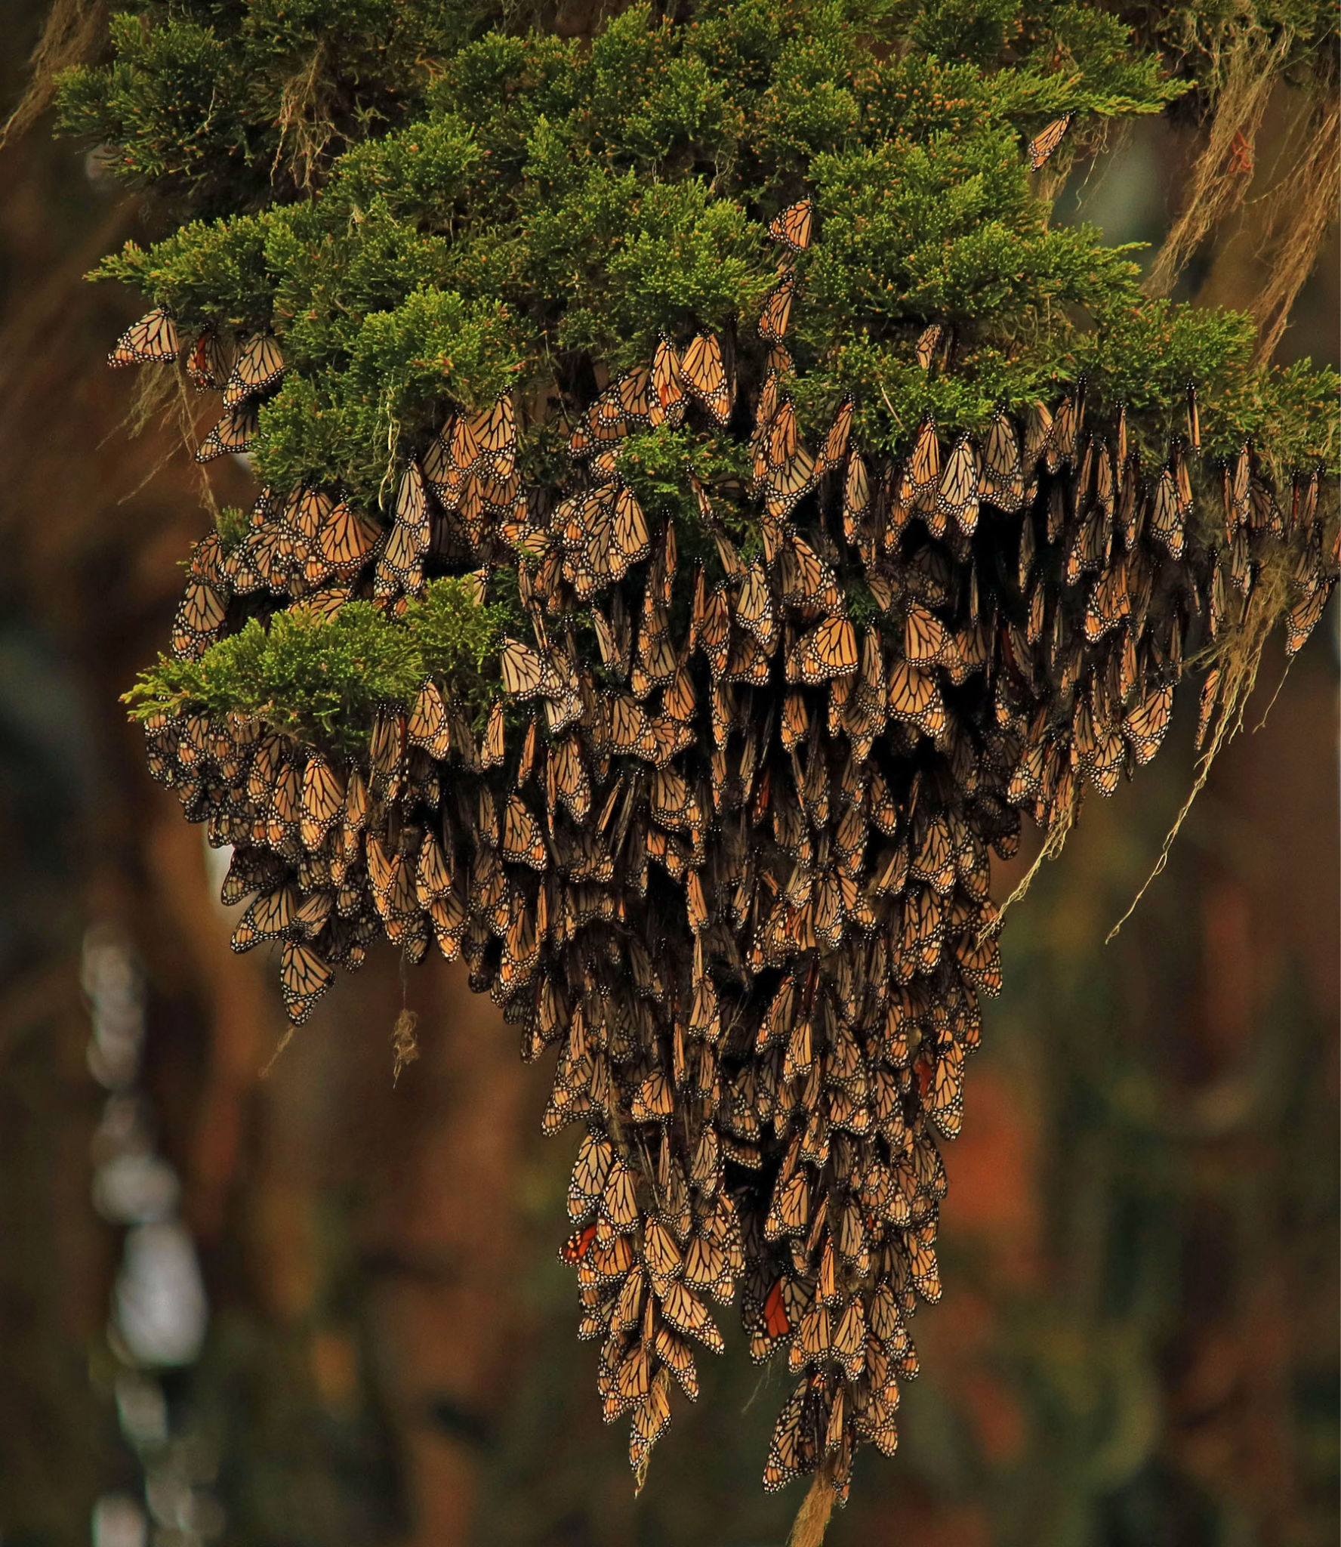
Study Background

Slide 3
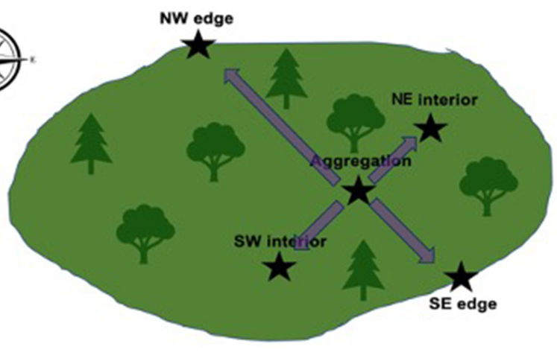
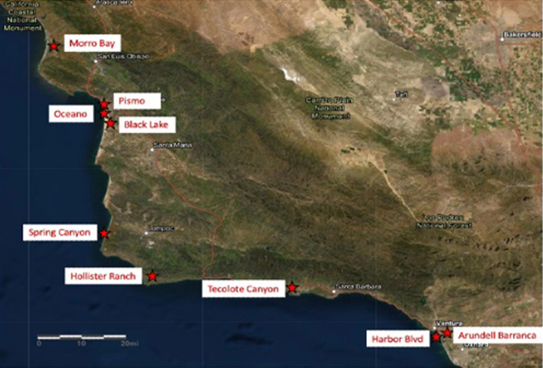
Study Design

Slide 4

Study Design
Level 1
Level 2
Point Conception
N
S
= 0
= 1

Slide 5
Model Considerations
Model we wanted to run:
monarch_presence ~ temp.avg + hum.avg + light.avg + seasonDay +(1 + seasonDay | grove)
What we had to run:
temp.avg ~ monarch_presence + seasonDay +(1 + seasonDay | grove)

Slide 6
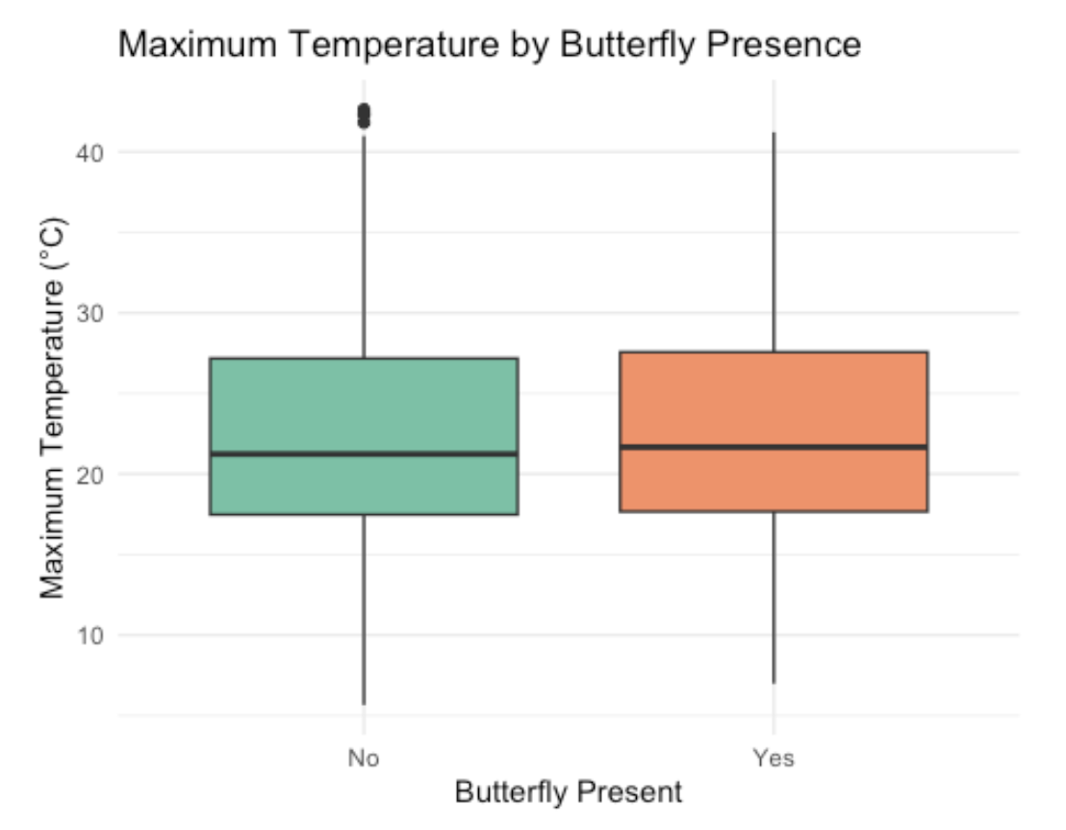
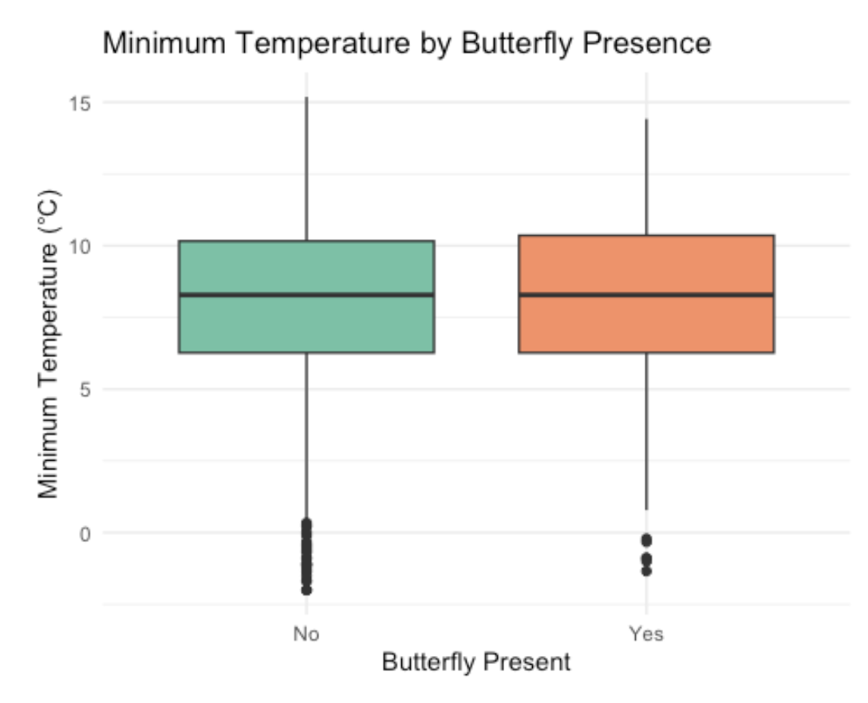
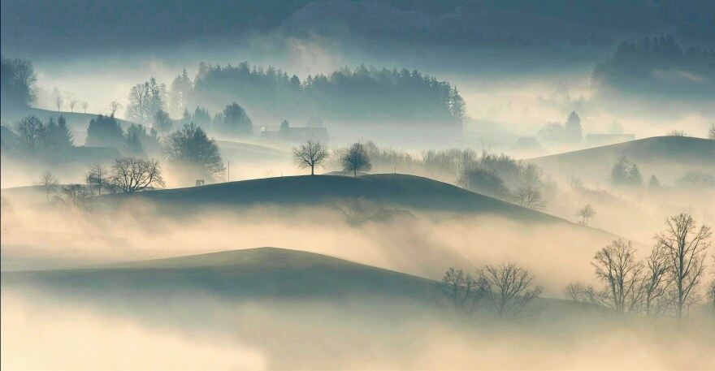
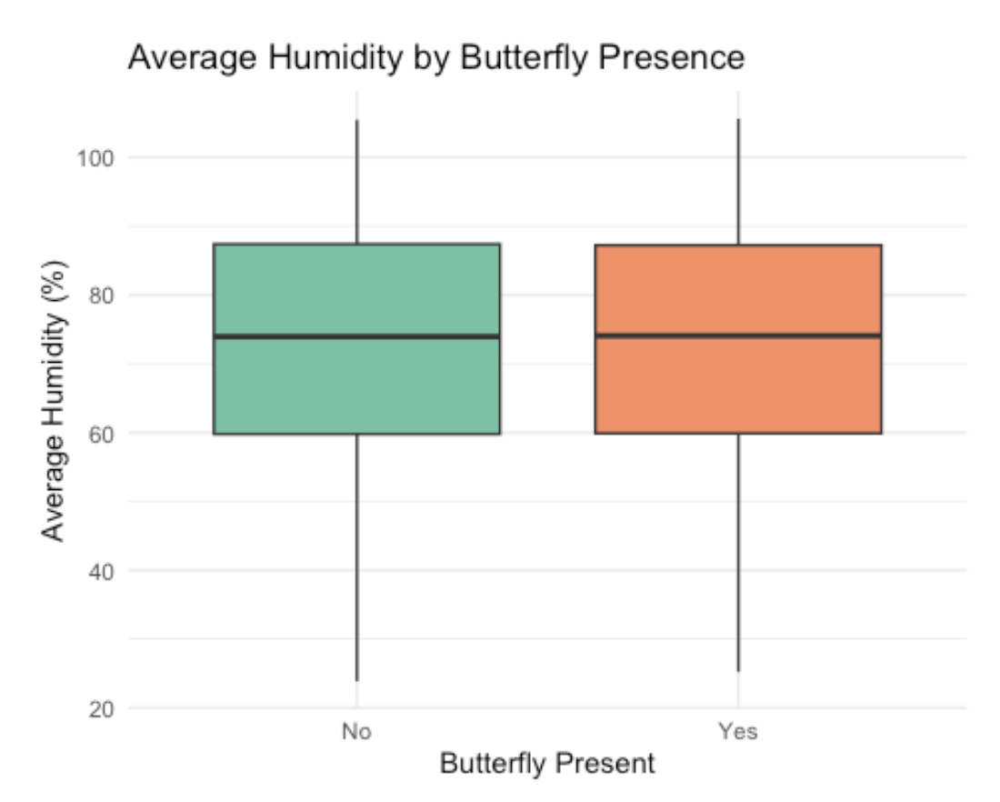
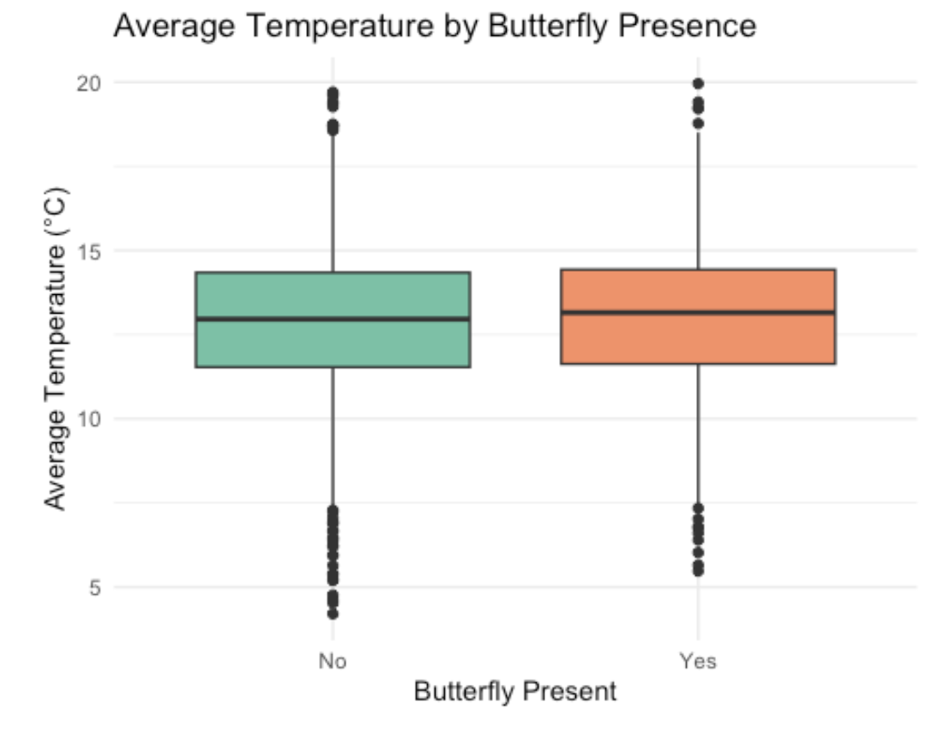
Results for Temperature and Humidity

Slide 7
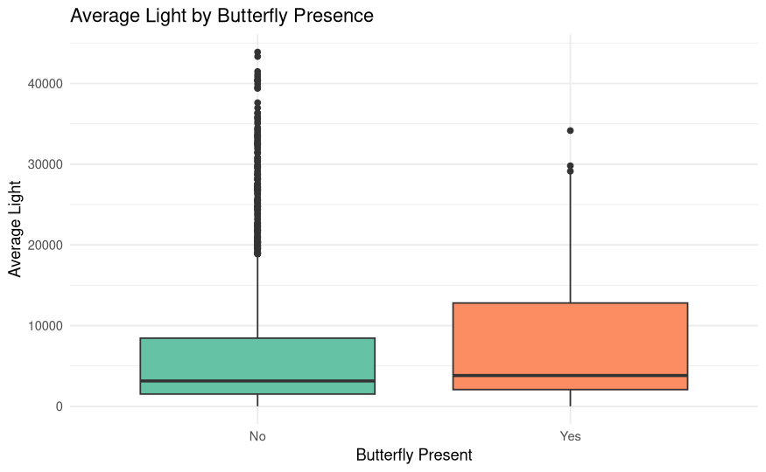
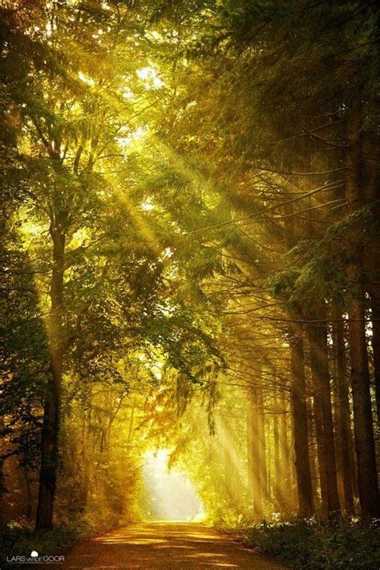
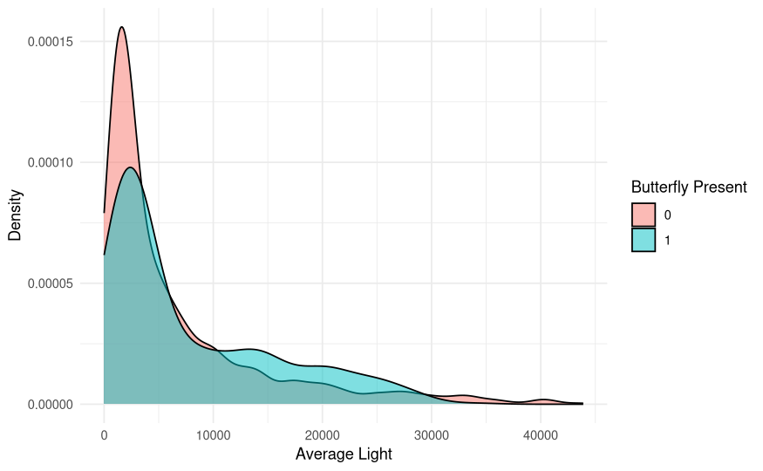
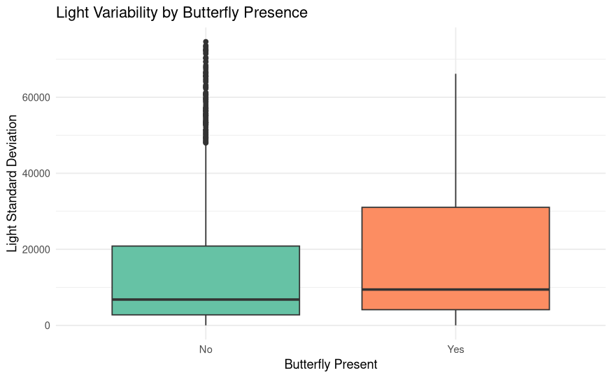
Results
(Light)

Slide 8
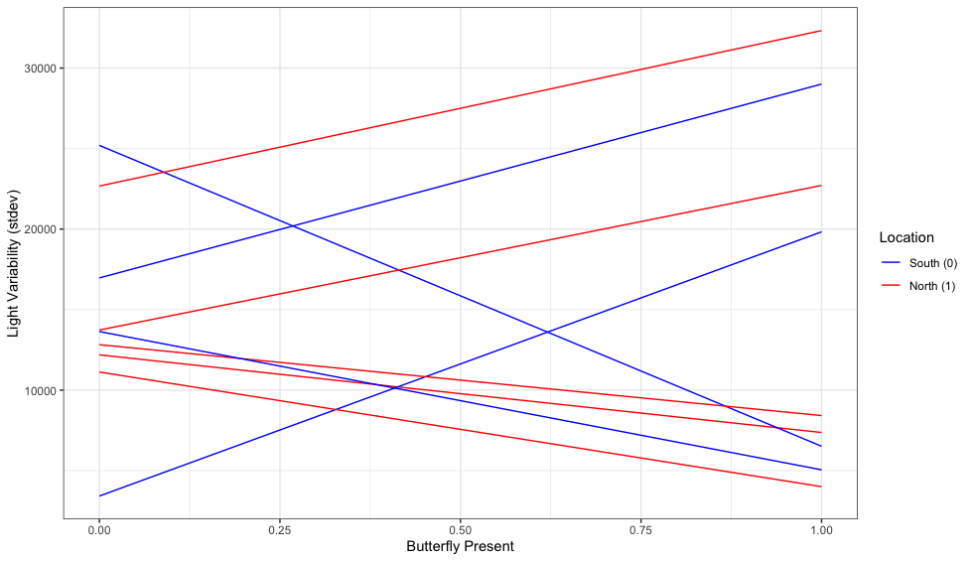
Results (Light)

